Slide 1
FIND THE INTEREST AMOUNT FOR Current YEAR
Team members:
899386 – Vyshnavi Garikapati
899433 – N sai Abhijith reddy
899490 – Navitha Jutur chinna reddy
899447 – Anusha VONTELA
899424 – Balla divya bhargavi

Slide 2
description
1. Find the EMI for Car with price of 15 Lac, Interest rate of 9.5% & Tenure 1 year; Display the interest amount & principal amount for one month 2. From Menu, pick Home Loan EMI Calculator, fill relevant details & extract all the data from year on year table & store in excel; 3. From Menu, pick Loan Calculator and under EMI calculator, do all UI check for text box & scales; change the Loan tenure for year & month, check the change in scale; Re-use the same validation for Loan Amount Calculator & Loan Tenure Calculator

Slide 3
Key automation scope
Validation of transactions & do calculations;
Extract table values & store in excel
Filling data in screen & multiple UI validations
Navigation from Menus
Reusable methods
Scrolling down in web page

Slide 4
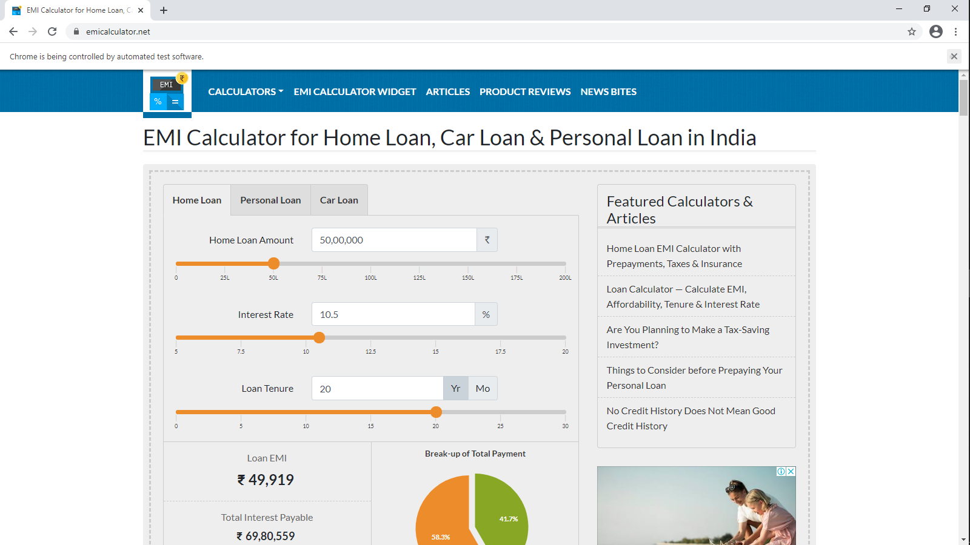
Test URL
Test URL: https://emicalculator.net/

Slide 5
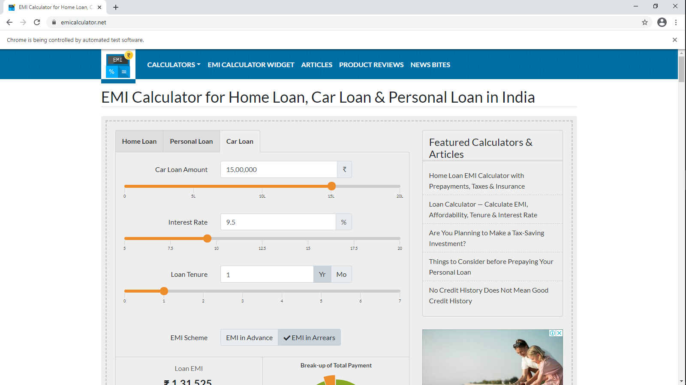
Car loan emi calculator

Slide 6
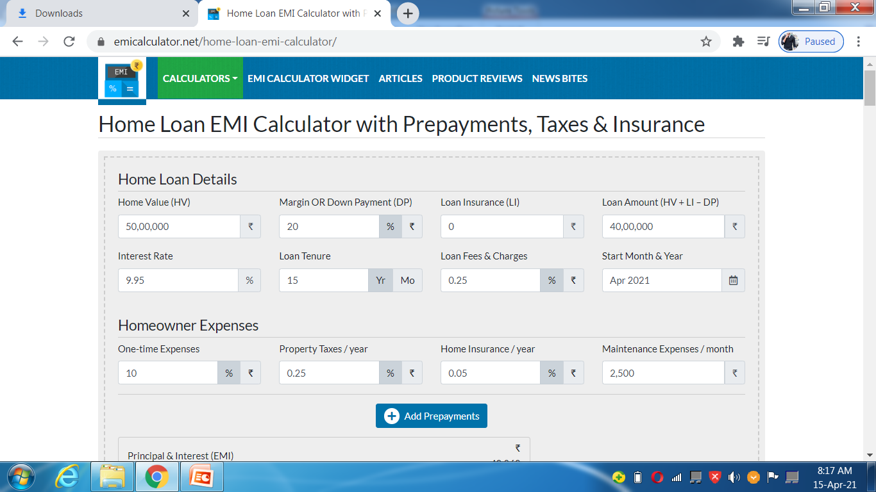
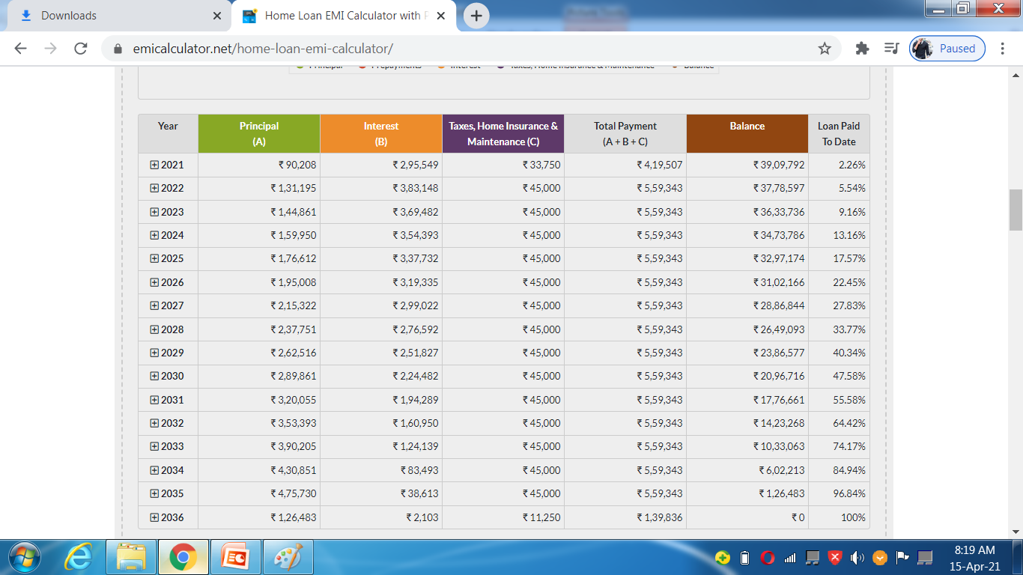
home loan emi calculator

Slide 7
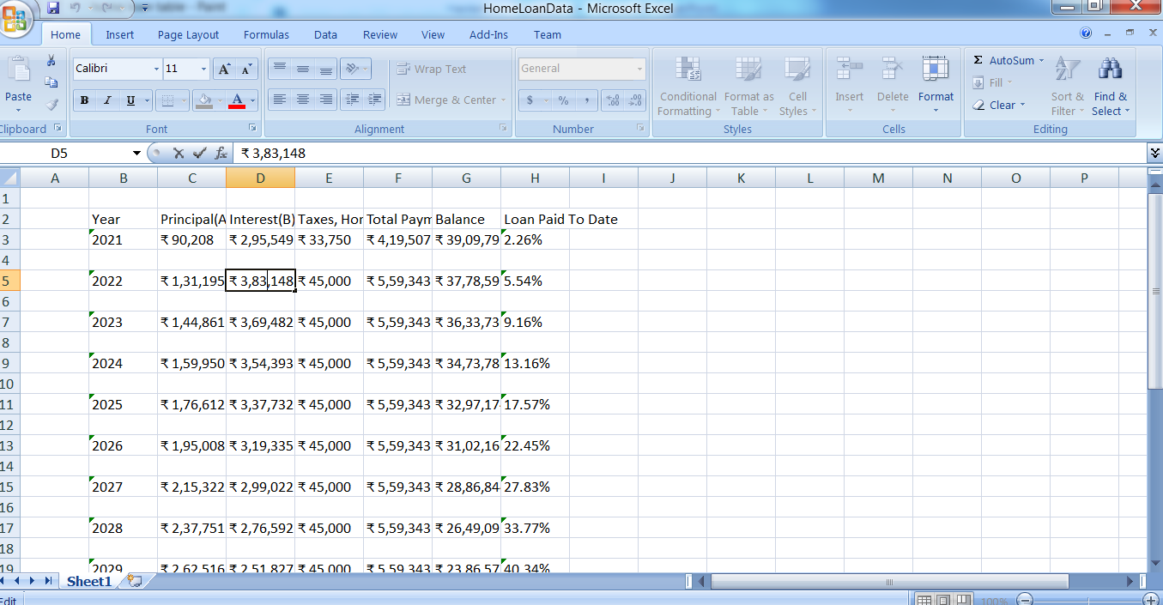
Writing data into excel

Slide 8
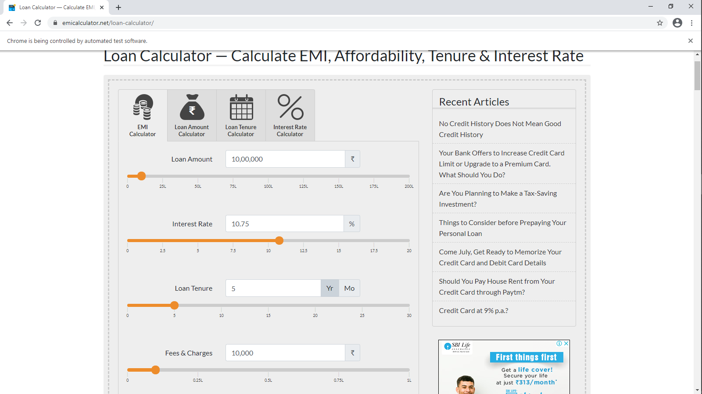
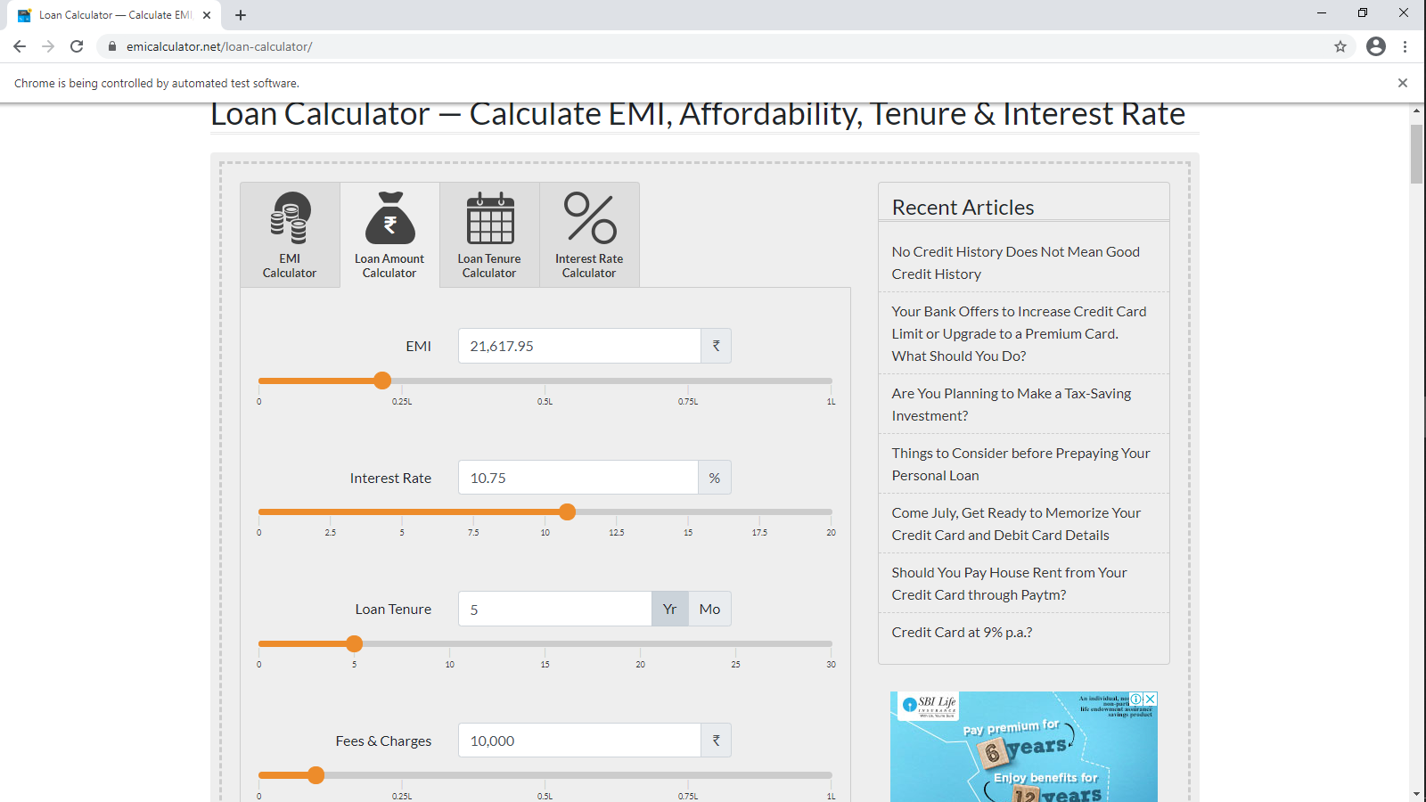
Loan calculators

Slide 9
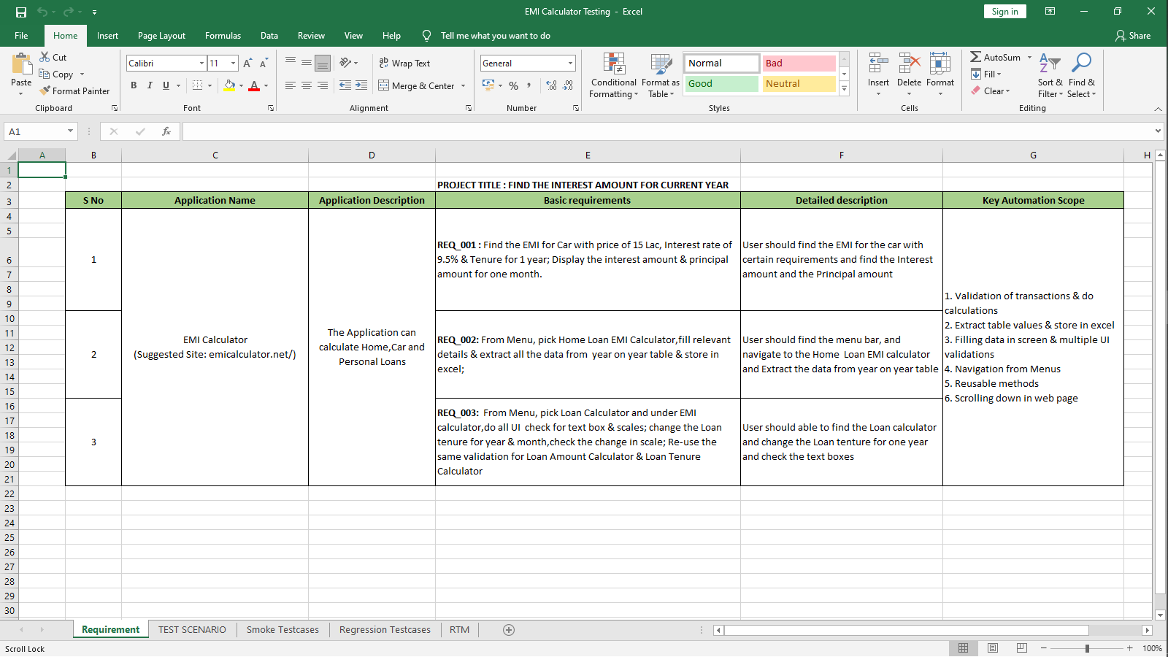
Testing requirements

Slide 10
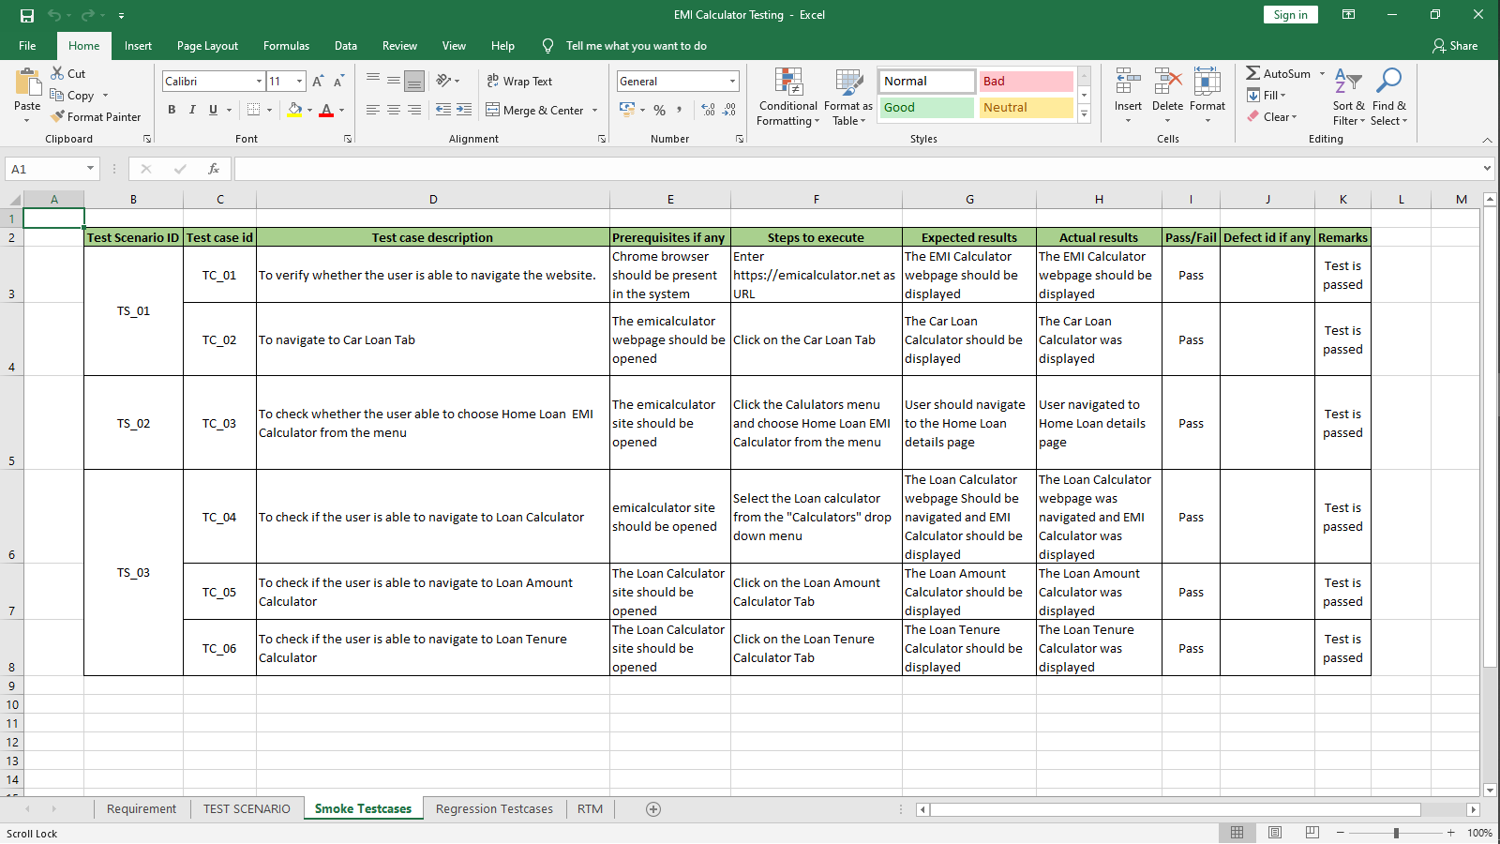
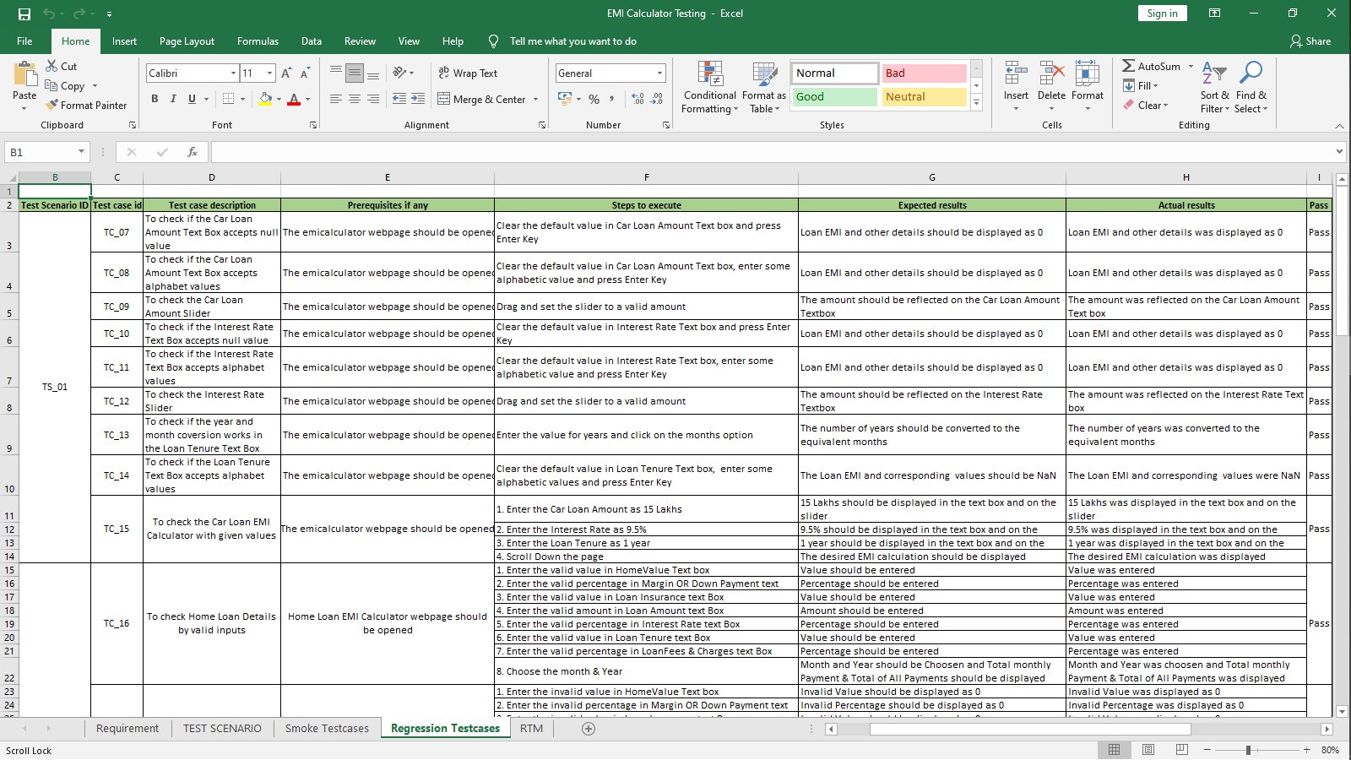
Smoke and regression testing

Slide 11
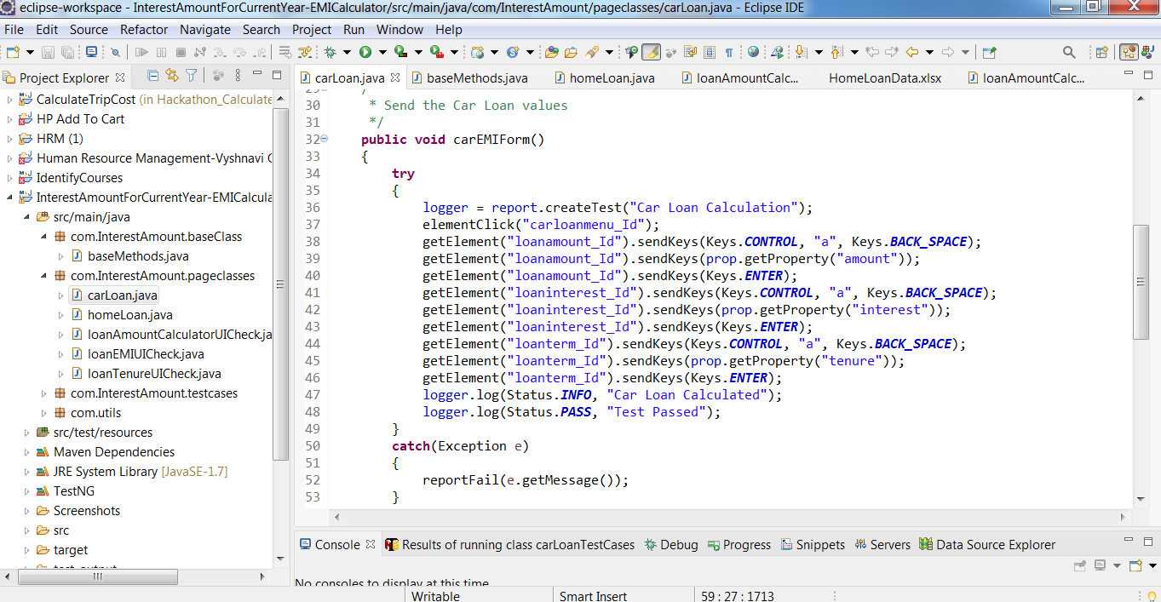
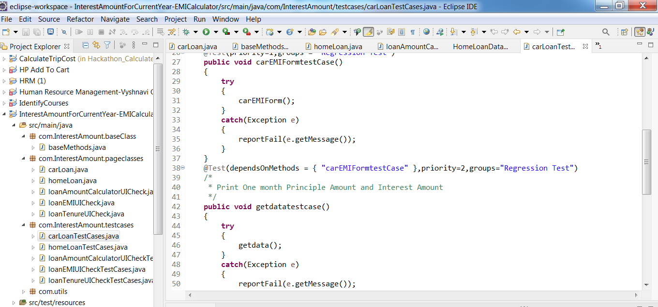
Automation scripts

Slide 12
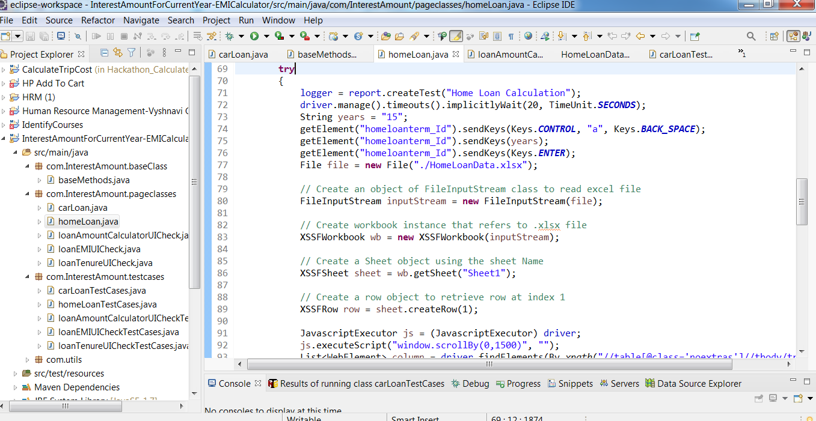
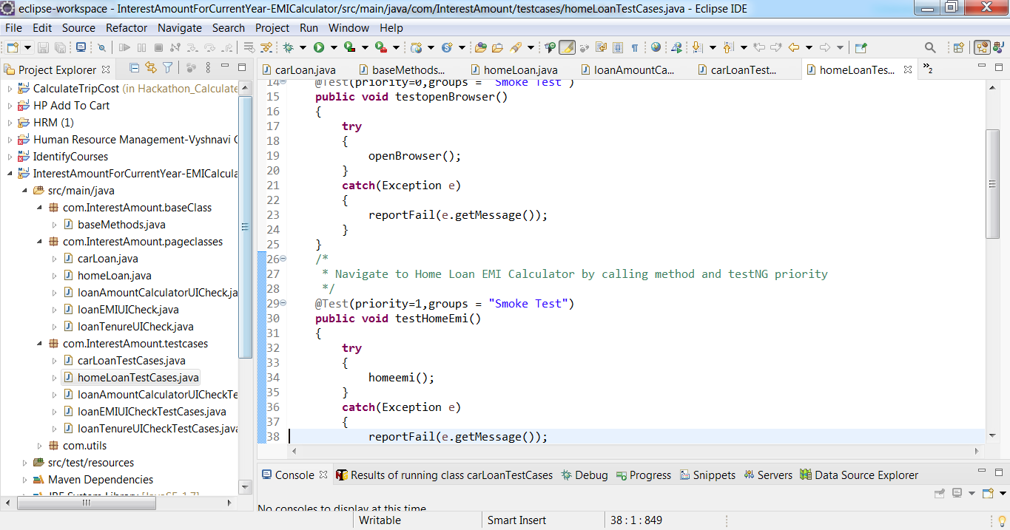
Automation scripts

Slide 13
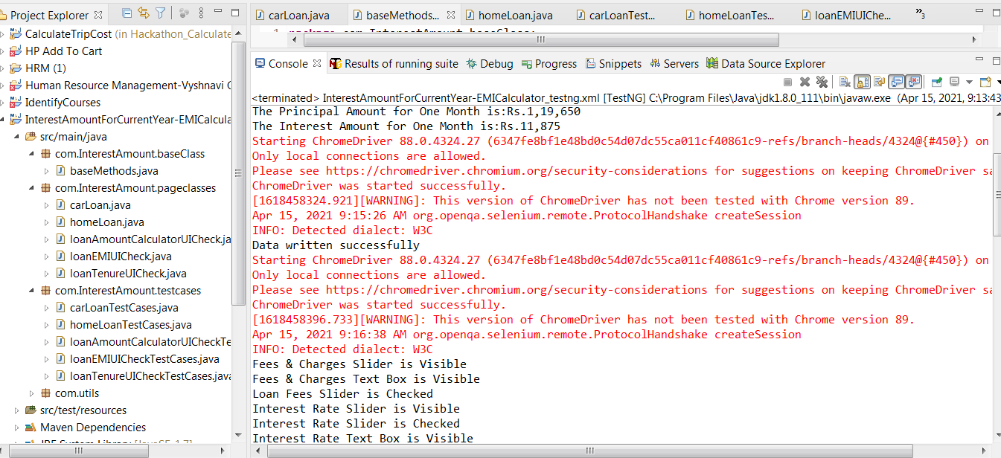
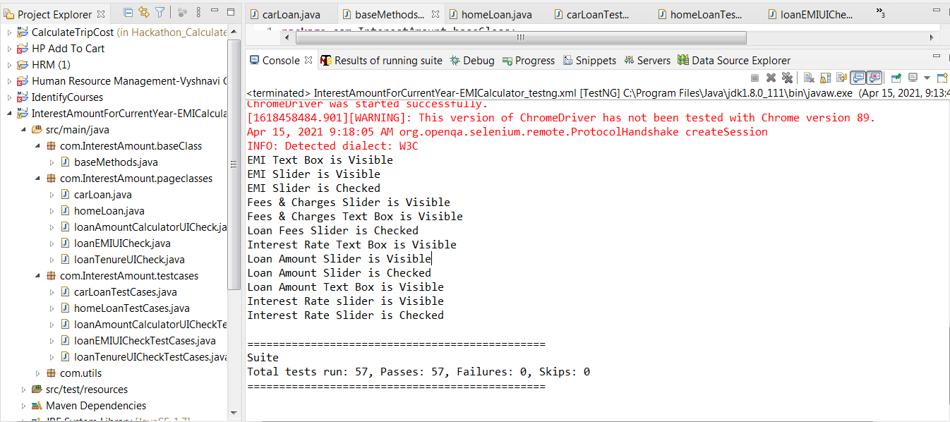
Automation scripts output

Slide 14
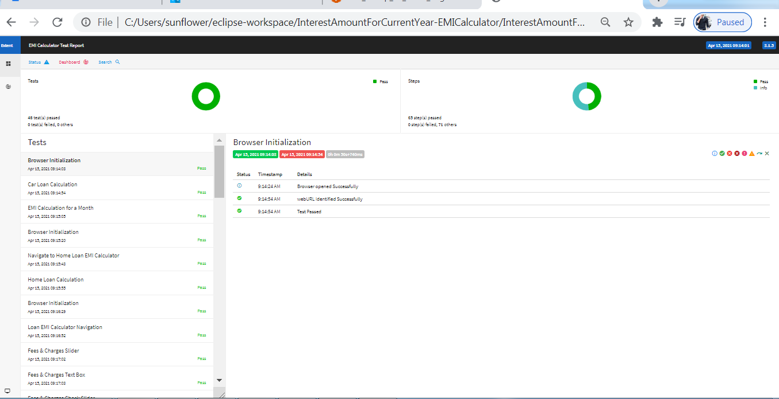
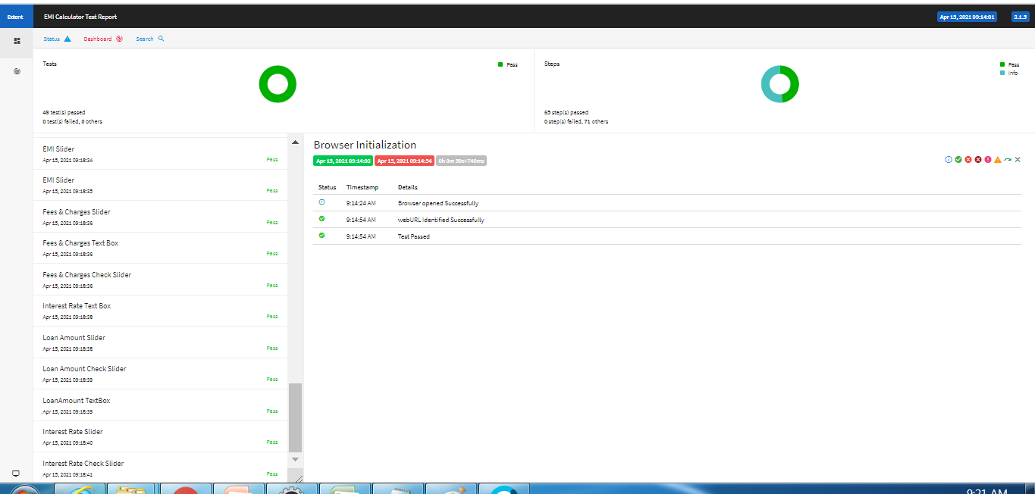
Report

Slide 15
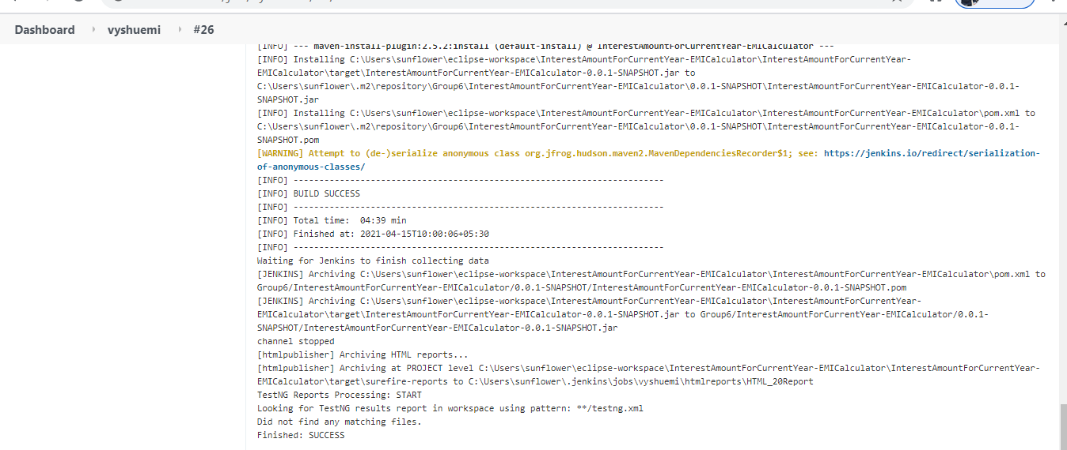
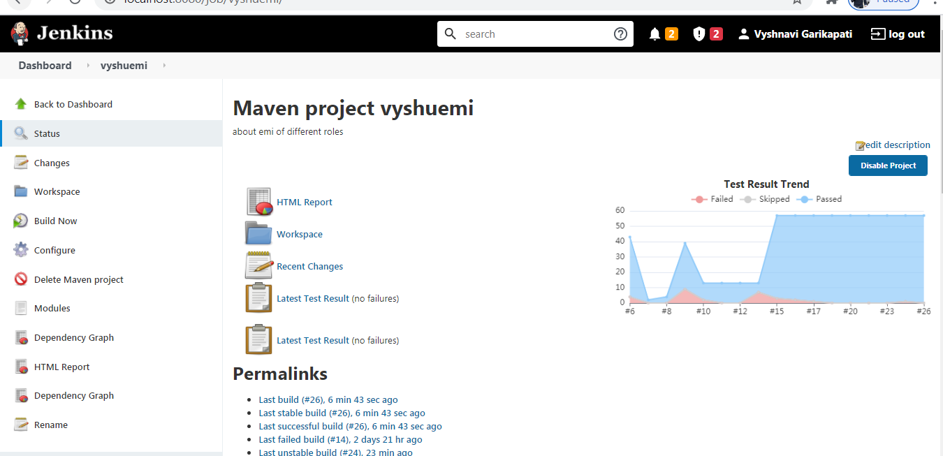
Jenkins

Slide 16
THANK YOU

